Slide 1
Week3 Project
Kaiye Chen

Slide 2
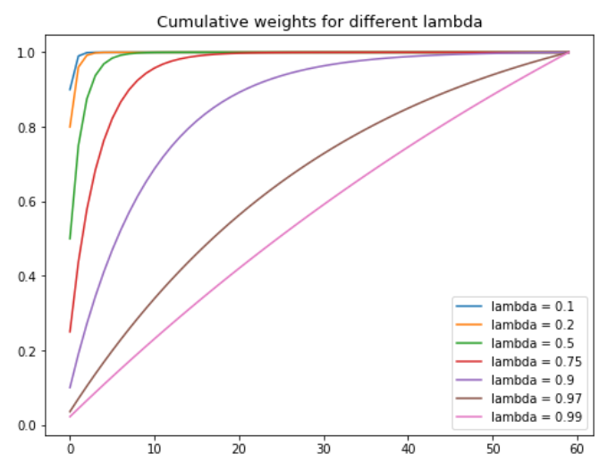
Problem1: Exponential Weight
lambda increases, the poportion
current day decrease
converging speed decrease

Slide 3
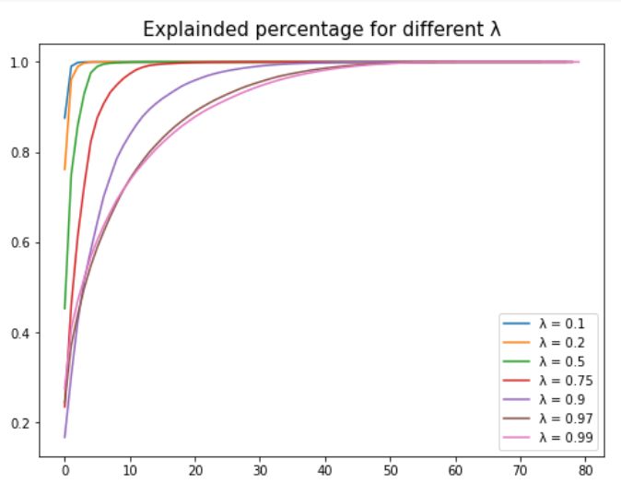
Problem1: Explained Percentage
Similar lambda relationship
Only 60 days, converge to 1 before
60

Slide 4
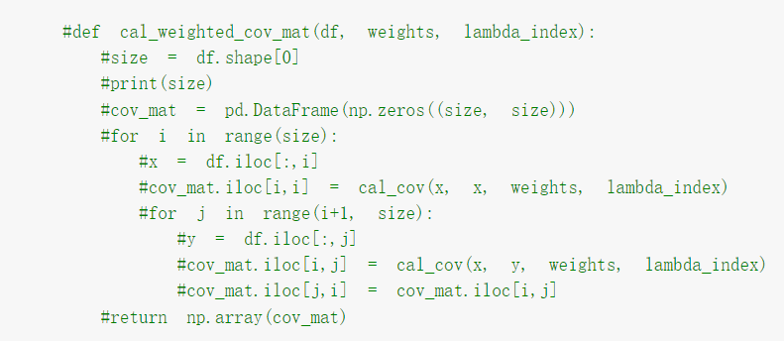
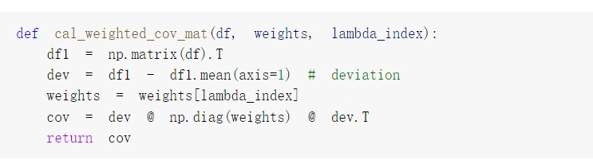
Problem1: Discussion: matrix dot Vs one by one
Matrix dot: consise, faster(O(n)),
difficult to understand
Calculate one by one: more code,
slower(O(n^2)), easy to get

Slide 5
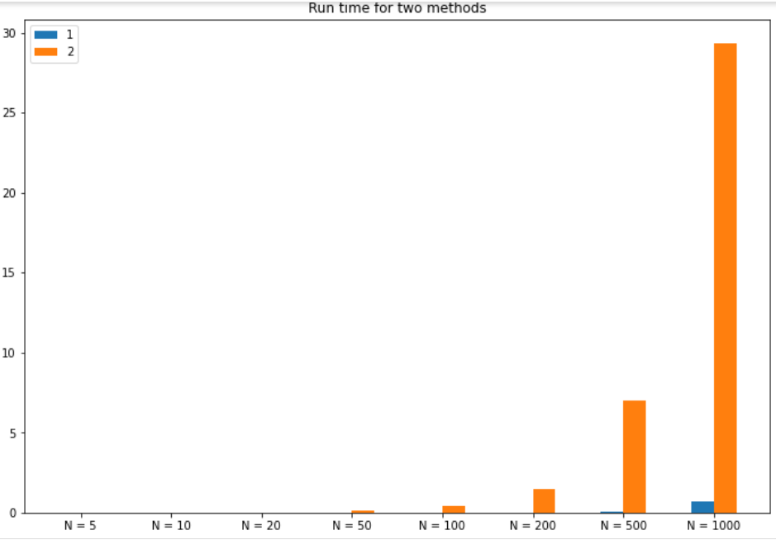
Problem2: Run time
Grow as N increases
Relationship: ^2 speed increase,
matrix has N^2 element

Slide 6
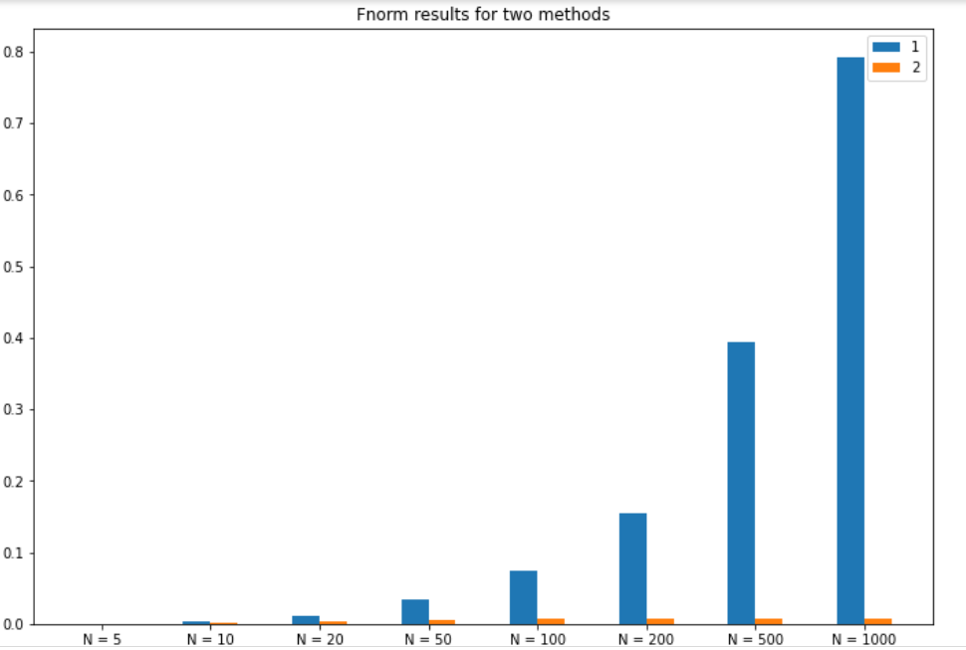
Problem2: Fnorm
Grow as N increases
Relationship: linear speed
increase, reason not clear
Comparing: trade-off between
run time and Fnorm

Slide 7
Problem2: Package and self-defined comparison
Our cholosky method: Have a very small negative eigen value tolerance(like 1e-8)
Cholosky method in numpy.linear package: Require very strict PSD,
raise an error when slightly non-PSD

Slide 8
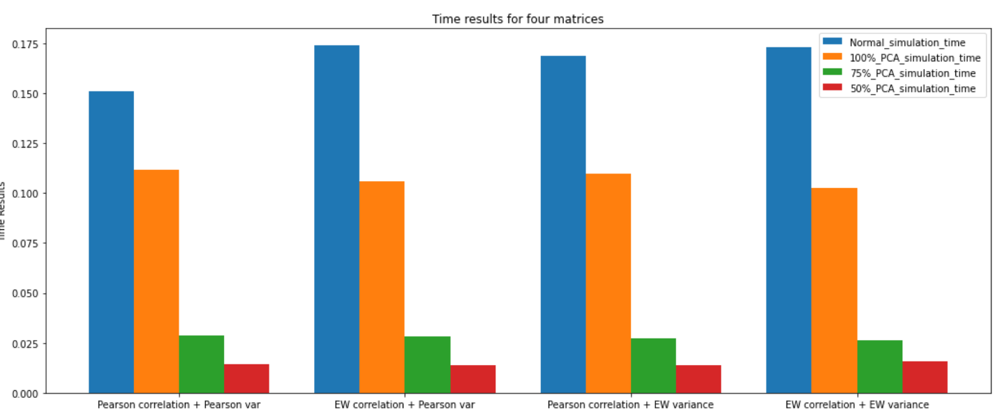
Problem3: Time results
Normal: Longest time
Time decreases as explained
ratio decreased
EW covariance longer
than pearson covariance

Slide 9
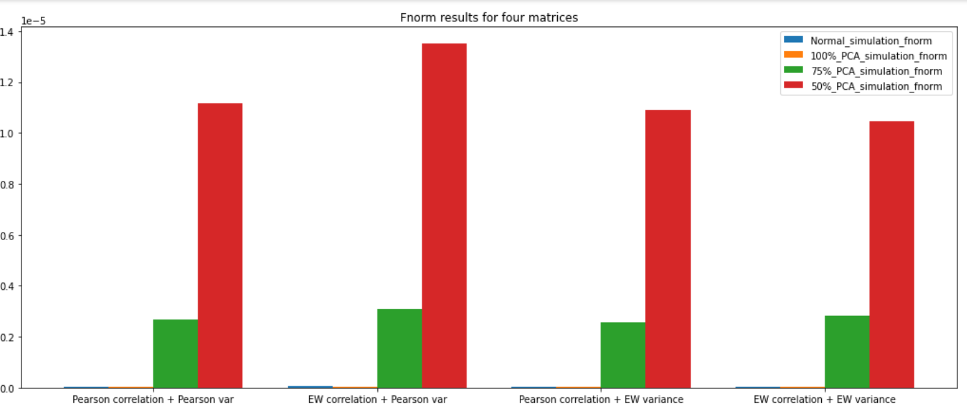
Problem3: Fnorm Results
Normal: lowest norm
Norm increases as explained
ratio decreased
Comparison: negative relationship
between run time and Fnorm

